Slide 1
Reasons to learn DevOps:

Slide 2
Anyone Can Learn DevOps:
People from different backgrounds can
learn DevOps.
Even a fresher with out having basic knowledge can learn DevOps.

Slide 3
Easy To Get A Job:
There is a lot of demand of DevOps professionals, but currently there are not enough people to meet the desired requirements for DevOps roles and responsibilities.
This leaves a huge window of opportunity for anyone seeking to make a mark for himself and DevOps can be a good career opportunity for them

Slide 4
Fat Paycheck: DevOps professionals are pretty highly paid across all geographies.

Slide 5
Separate Yourself From The Crowd: With DevOps knowledge you can offer something unique to your organization.

Slide 6
Fast Career Growth:
Up-scaling yourself is a necessity, especially nowadays when technology is evolving at a rapid pace.

Slide 7
Become More Valuable To The Company:
With DevOps you become more valuable to the company, since you know various tools and technologies used for development, testing and deployment.

Slide 8
The Trends and Future of DevOps
DevOps in the Security Field
The field of security is peculiar because the more you automate, the higher chances of automating problems too. So all automation being done in this area to be intrinsically controlled, and this brings enormous scope for DevOps philosophy.

Slide 9
Automation for Every Company
In today’s world, everything happens over the internet. Most companies are changing to be like an IT company that provides some particular services. For example, booking.com was a travel company which now functions as an IT company that provides travel services

Slide 10
AI/ML in the DevOps Framework
The software development life cycle is revolutionized with the DevOps methodology, cloud-native approach, and microservices architecture.
Applying AI and ML to the DevOps pipelines can help you run builds and automation in a much better with closer insights a control.

Slide 11
In 10 Years, DevOps Will Look Extremely Different
For one thing, containers will become the bread and butter of the execution of applications. It could even become the standard-bearer of both “Dev” and “Ops”. Additional technological changes could include functions that can operate without servers. Along with microservices, the structure of the application will become more flexible in its operations. However, some downsides from these changes can include technology becoming a bit more difficult to manage over time.

Slide 12
Data Science and Artificial Intelligence
Many companies that have implemented DevOps into their business practices have received numerous benefits. In the future, data science teams may use DevOps development practices due to the prevalence of custom application development. When data scientists use DevOps, they can redo production models while testing previous models that they already deployed. The trend will only get more popular as custom application development teams and data scientists come together to maintain different applications.

Slide 13
Market standards
DevOps Market size is expected to grow from USD 2.90 Billion in 2017 to USD 10.31 Billion by 2023, at a Compound Annual Growth Rate (CAGR) of 24.7% during the forecast period. The demand for DevOps solutions and services among enterprises is expected to gain huge traction, due to the increasing need for fast application delivery with high quality. The base year considered for this study is 2017 and the forecast period is 2018–2023.

Slide 14
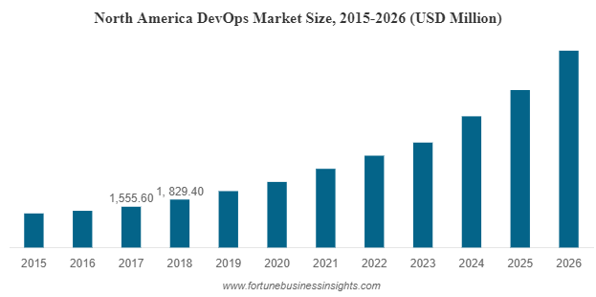

Slide 15
The global development and operations (DevOps) market size stood at USD 3,709.1 million in 2018 and is projected to reach USD 14,969.6 million by 2026, exhibiting a CAGR of 19.1% during the forecast period.
Read More at:-
https://www.fortunebusinessinsights.com/devops-market-102040

